Slide 1

Session 6:
Modeling States with UML Statechart Diagrams
Analysis and Specification of Information Systems
Spring 2008
Eran Toch
http://www.technion.ac.il/~erant

Slide 2
Outline
Introduction to Statecharts
Statechart building blocks
  States
  Transitions
Advanced Characteristics
  Composite States
  Parallel States

Slide 3
Modeling Process in UML
Phase | Actions | Outcome
Initiation | Raising a business need | Business documents
Requirements | Interviewing stakeholders, exploring the system environment | Organized documentation
Specification | Analyze the engineering aspect of the system, building system concepts | Formal specification
Design | Define architecture, components, data types, algorithms | Formal Specification
Implementation | Program, build, unit-testing, integrate, documentation | Testable system
Testing & Integration | Integrate all components, verification, validation, installation, guidance | Testing results, Working sys
Maintenance | Bug fixes, modifications, adaptation | System versions
Intro | Building Blocks | Advanced
Notes:
Statechart are more focused in Design than in Specification. Their expressability is equal to programming code.

Slide 4

What’s Missing in Behavior Modeling?
p : Product
: ShooppingCart
customer
display()
getPrice()
addProduct (p)
checkout ()
In Sequence diagram, we do not really know how the state of the shopping cart changes.
Intro | Building Blocks | Advanced
Notes:
This slide tries to give an example of why is not sequence diagram enough.
we need some language for modeling the behavior of an individual object, in order to:
Model how an object responds to events
Enumerate the possible states of an object
Model how the history of an object can affect its behavior

Slide 5
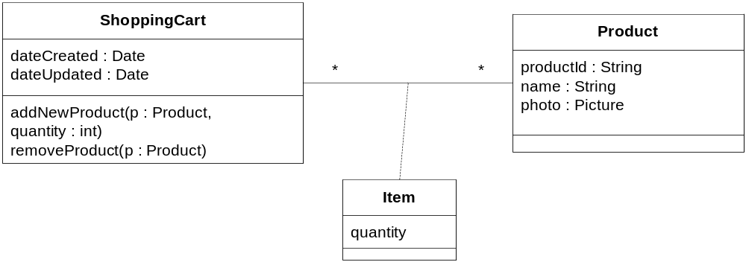
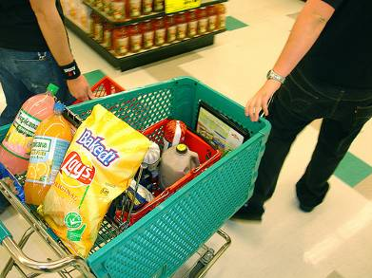
Modeling States
How can we model the state of the shopping cart?
Depends on:
  Object state (e.g. created, destroyed)
  Variable assignment
  Relation status (i.e. number of items)
  Operating methods & processes
  History
Intro | Building Blocks | Advanced
Notes:
The basic question: how can we determine the states? What changes them?
History is problematic: a cart which was emptied, and one which never had any products are, theoretically, in two different states. We need a good way to model it.

Slide 6

The Automata
A machine whose output behavior is not only a direct consequence of the current input, but of some past history of its inputs.
Characterized by an internal state which represents this past experience.
If the phone is ON, then clicking will turn it off
If the phone is OFF, then clicking will turn it on
Intro | Building Blocks | Advanced
Notes:
Draw the two options for action on the board (clicking turns on, and clicking turns off), using two arrows. The places from which the arrows are coming from are considered the STATES of the machine, reflecting the history of the machine.

Slide 7
Automata – Mathematical Foundations
An Automata is a 4-tuple: ⟨S,Σ, δ,S₀⟩
  S is a set of states
  Σ is an alphabet - finite set of symbols
  δ is the transition function: δ : S × Σ → S
  S₀ is an initial state
Many uses:
  Stochastic processes (x, y & z are probabilities)
  Formal and natural languages (x, y & z are characters)
  Complex systems (x, y & z are…)
Given a state and an input, the automata jumps to a new state
click
off
click
on
S₀
Intro | Building Blocks | Advanced
Notes:
Note that final states are omitted, for the sake of simplicity.
The automata structure is too simple for real systems:
1. What is “click”? We need a formal definition of actions.
2. What about shared behavior? For instance, “off” and “on” behave similarly when the battery is taken out: “click” would not work then

Slide 8
Automata Modeling with Statecharts
A Statechart augments deterministic automata, making them suitable for specifying behavior of complex systems, using:
  Visual formalism
  Rich alphabet model
  State Modularity
  Parallel behavior
Developed by David Harel (Weizman Inst.)
Intro | Building Blocks | Advanced

Slide 9
Outline
Introduction to Statecharts
Statechart building blocks
  States
  Transitions
Advanced Characteristics
  Composite States
  Parallel States

Slide 10
States & Classes
Class view
State view
State
created
Order
Transition
status: {created, sent,
received}
hasProblems : boolean
in gathering
gatherItems()
updateInventory()
sendOrder()
received(customer)
sendReciept()
sent
is received
in problem
Intro | Building Blocks | Advanced
Notes:
Should add notes for initial and final states.

Slide 11
Activities
When holding the state, the component can perform activities.
  Can be continuous, taking a specific, or unbounded, time
  Activities within a state are sequential
  Activities can be interrupted
There are special types of activities: enter, exit and event classified activities
in gathering
do: gatherItems()
do: updateInventory()
created
enter: set hasProblems to false
do: init gathering list
exit: clean log file
Intro | Building Blocks | Advanced

Slide 12



Transitions
event [guard] | action
x
y
The action that takes place when the transition is taken
The event that triggers the transition
Conditions that must be met for the transition to take place
Intro | Building Blocks | Advanced

Slide 13
Events
General Events
  Method calls: received(customer)
  Event signals: inventoryReady
Time event
  interval expiry;
  tm(3 days), tm(1000 ms)
  calendar/clock time; when(11:50)
Change Event:
  Change in value of some entity; false(hasProblems)
  true(hasProblems)
created
inventoryReady
in gathering
false(hasProblems)
sent
tm(3 days)
received()
in problem
is received
Intro | Building Blocks | Advanced

Slide 14
Guards (Conditions)
gatheringFinished [all items were gathered]
sent
in gathering
in problem
gatheringFinished [items are not found]
Boolean expressions.
Evaluated when the transition is triggered
Types of guards:
  Simple predicate: [hasProblems], [x > 0]
  Combined predicates:
  [¬hasProblems ∨ (hasProblems ∧ order.sum < 100]
  Guards on activities: [active(gatherItems)]
  State related (we’ll get back to it later)
Intro | Building Blocks | Advanced

Slide 15
Guards - Example
bid [value < 100]
Selling
bid [value >= 200]
Happy
bid [(value >= 100) AND (value < 200)]
Unhappy
Intro | Building Blocks | Advanced
Notes:
Guards are evaluated only when an event is catched. If no bid is ever throwed, then

Slide 16
Static Conditional Branching
A graphical shortcut for convenient rendering of decision trees
Selling
Happy
bid
[value >= 200]
[value < 100]
[(value >= 100) & (value < 200)]
Unhappy
Intro | Building Blocks | Advanced
Notes:
Note that the “bid” event is mentioned only once

Slide 17
Empty Transitions
A transition can have any combination (including none) of the events, guards and actions
When a transition does not have an event, it is taken after all the activities were ended
Empty Transition
Employee
rest[break]
Cleaning
do: put water
do: put soap
do: wash soap
do: drain
Working
do: shovel
doing nothing
work
work
Intro | Building Blocks | Advanced
Notes:
The objective here is to show what the semantics of empty transitions. We take it after all activities were over. If the state does not contain any activities, then the transition is taken immediately.

Slide 18
Guards and Events
What’s the difference between the two machines?
S1
E1
S2
true(C)
S3
S1
E1
S2
[C]
S3
What happens if C changes to True before E1?
Intro | Building Blocks | Advanced

Slide 19
Actions
An executable atomic computation
Types of actions
  Variable assignment:
  Throwing a signal:
  Start, or stop activities (and concatenation of actions):
sent
received() | status := received
is received
sent
received() | throw(InventoryUpdate)
is received
sent
| start(sendBill); stop(delivery); x := x+1
is received
Intro | Building Blocks | Advanced

Slide 20
Transitions - advanced
Self-transitions: Transitions can be directed to the same state:
Un-deterministic states – when two transitions are taken in the same time, one of will be taken in an un-deterministic fashion:
/ c=0
S2
E1 / c:=c+1
S1
E1
S2
[C1]
S3
Intro | Building Blocks | Advanced

Slide 21

How does a Washing Machine Works?
On / Off button. Start button (No stop button.)
Feedback is given on the current stage (soaking, rinsing, draining, drying)
Three plans:
  Regular
  Delicate (no soaking)
  Super delicate (no soaking, no drying)
Off can be clicked only before starting, or after finishing
Intro | Building Blocks | Advanced

Slide 22
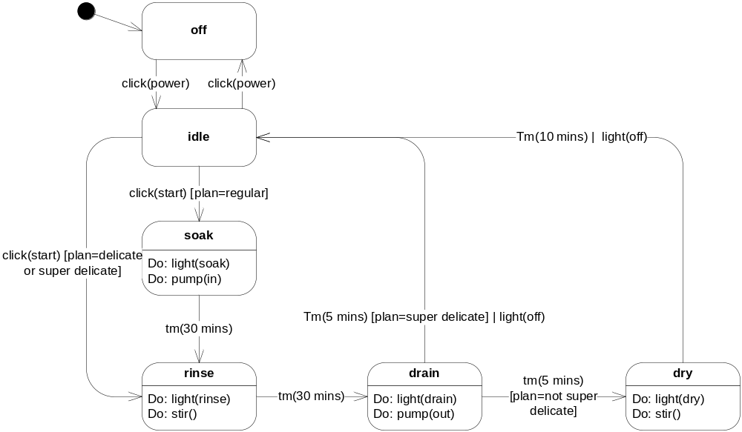
Washing Machine
Intro | Building Blocks | Advanced

Slide 23
Outline
Introduction to Statecharts
Statechart building blocks
  States
  Transitions
Advanced Characteristics
  Composite States
  Parallel States

Slide 24
State Explosion: An Example
What is the off button can be clicked at any time?
What if we want to show how many minutes left to the end of the cycle?
What if we want to come back to the same state we left?
Intro | Building Blocks | Advanced

Slide 25


Abstraction in Statechart
Finding Common Behavior
Separating Independent Regions
Composite States
Parallel States
Intro | Building Blocks | Advanced

Slide 26
The State Explosion Problem
Class 1
Class 2
Class n
v₁ : {t, f}
v₂ : {t, f}
v₃ : {t, f}
...
v_{m} : {t, f}
v₁ : {t, f}
v₂ : {t, f}
v₃ : {t, f}
...
v_{m} : {t, f}
v₁ : {t, f}
v₂ : {t, f}
v₃ : {t, f}
...
v_{m} : {t, f}
...
Let
  n: Num of Classes
  m: Num of variables (assume equality among classes)
Number of possible states = 2^{(nm)}
And...
  What if the state space of each variable > 2
  What about association between objects?
Intro | Building Blocks | Advanced
Notes:
This slide should be before the parallel states explanation

Slide 27
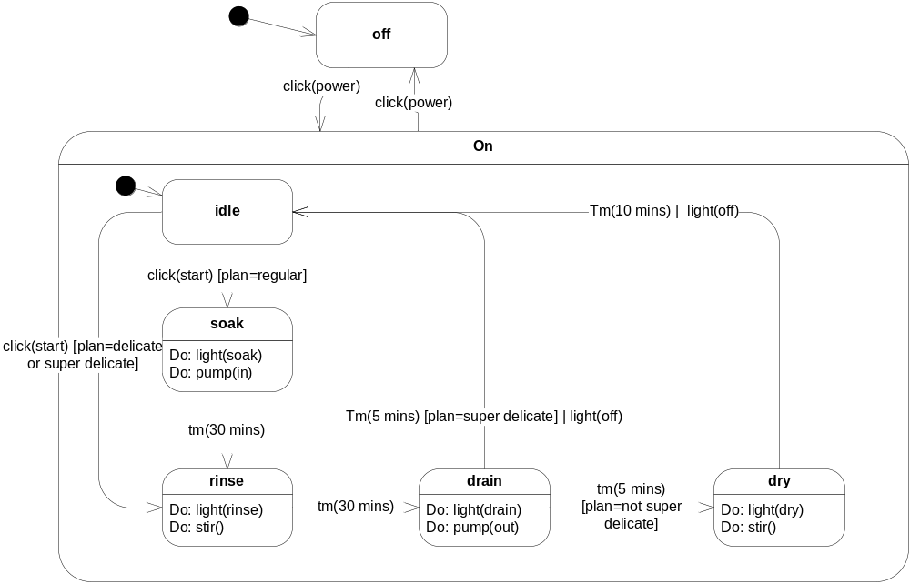
Composite States
Intro | Building Blocks | Advanced
Notes:
Composite states give us a level of abstraction in statechart modeling
Formally, a common characteristics for a group of states is the common transition they share
Composite states can aid in:
Allowing better understanding of a system model
Dramatically reducing the number of transitions
Reducing errors by employing initial states
Rules for composite states:
Each composite state must have an initial state and some final states

Slide 28
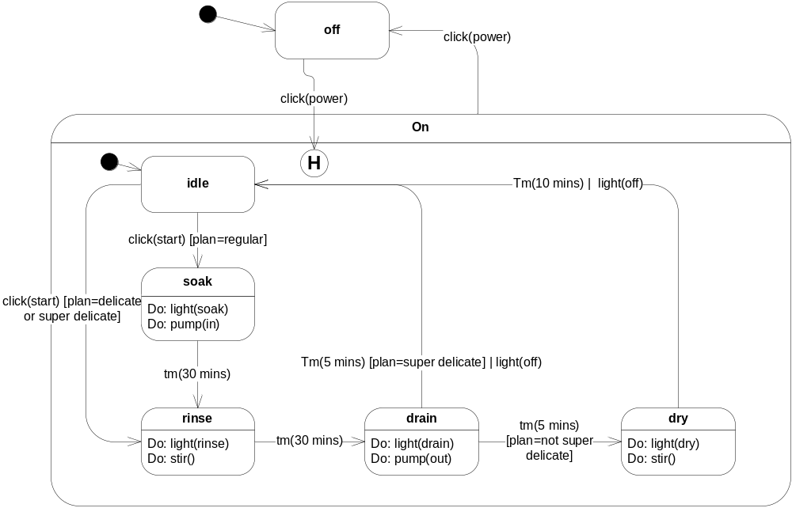
Composite + History

Slide 29
deep and shallow
Stop
Shift ended | clh()
pause
Diagnosing
return
H
Diagnostic1
Diagnostic2
return-full
H*
setup
Find a vein
clh() – clears the history
Check blood pressure
Draw Blood
Intro | Building Blocks | Advanced

Slide 30
Completion Transitions
Triggered by a completion event
  generated automatically when an immediately nested state machine terminates
Committing
completion
transition (no trigger)
Phase1
Commit Done
Phase2
Intro | Building Blocks | Advanced

Slide 31
Triggering Rules
Two or more transitions may have the same event trigger
  inner transition takes precedence
  if no transition is triggered, event is discarded
LampFlashing
FlashOn
on/
off/
on/
FlashOff
Intro | Building Blocks | Advanced

Slide 32
Order of Actions: Complex Case
Same approach as for the simple case
S1
exit:exS1
S2
entry:enS2
| initS2
S11
exit:exS11
E/actE
S21
entry:enS21
Actions execution sequence:
exS11⇨ exS1 ⇨ actE⇨enS2 ⇨ initS2 ⇨ enS21
Intro | Building Blocks | Advanced

Slide 33

Parallel States
Sometimes, some aspect of an entity are independent of other aspects
Martial
employee
single
Staff
Member
married
Manager
divorced
Intro | Building Blocks | Advanced

Slide 34
Parallel States Annotation
Combine multiple simultaneous descriptions
Martial
employee
single
Staff
Member
married
Martial
employee
single
Manager
divorced
Staff
Member
married
divorced
Manager
Intro | Building Blocks | Advanced

Slide 35
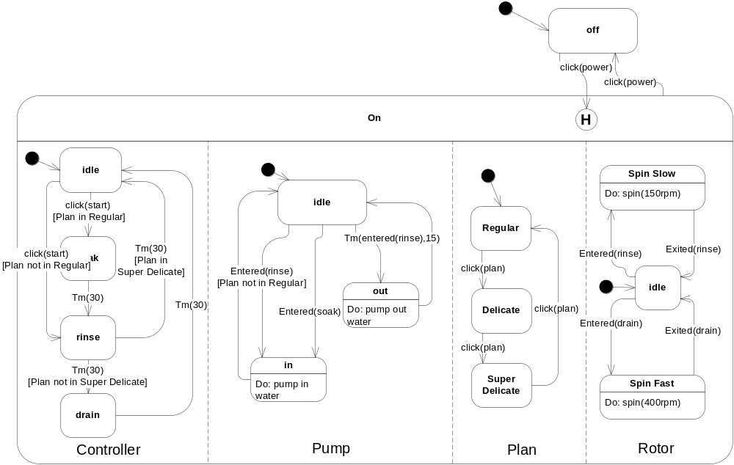
Interactions Between Parallel States
Intro | Building Blocks | Advanced

Slide 36
“Flat” and Parallel Machines
Every parallel machine can be transformed into a sequential machine:
A
D
μ
E
B
Use of
Orthogonal Regions
γ
δ
F
α
β
(in G)
α
C
G
μ
δ
B,F
B,E
γ
B,G
α
α
β
No Use of
Orthogonal Regions
α
C,E
γ
α
C,G
μ
C,F
δ
Intro | Building Blocks | Advanced

Slide 37
Transition Forks and Joins
For transitions into/out of orthogonal regions:
shipping
Processing
Sent
Confirmed
Credit Card
verification
[ok]
Receipt Sent
fork
[not ok]
Join
charging
In problem
Intro | Building Blocks | Advanced
Notes:
If we use a join, the composite states ends when all parallel regions had ended. If we use a simple transition (such as the one between “credit card verification” to “In Problem”), then we exit all the parallel states.

Slide 38
Summary
Statechart:
  State-based modeling
  Based on Automatas
Statechart building blocks
  States
  Transitions
Advanced Characteristics
  Composite States
  Parallel States

